Slide 1
Draw website
Muresan Vlad Muresan Rares

Slide 2
Contents
In this project we have tried to create a login screen where you would be able to enter with a valid account. The account would be used to access a drawing page where an image can be created.

Slide 3
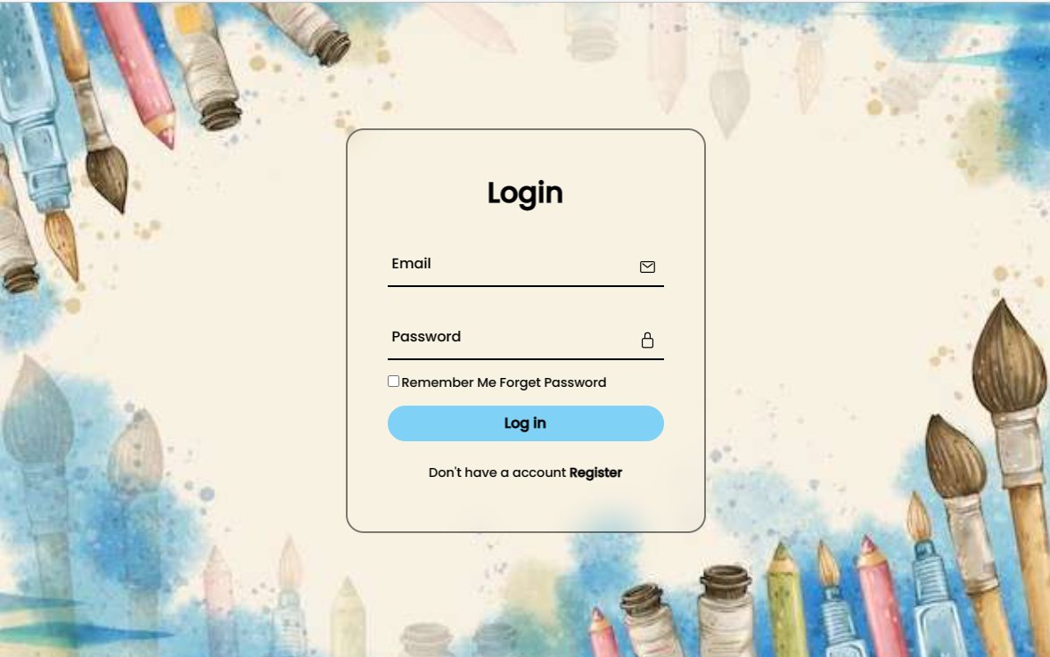
The login Screen

Slide 4
The Login screen
The login screen has two text boxes, one for the user name, the other for the password
It also contains the login button, the register button, that would send us to the register tab, and the forgot password button where we would be able to change our password through our email

Slide 5
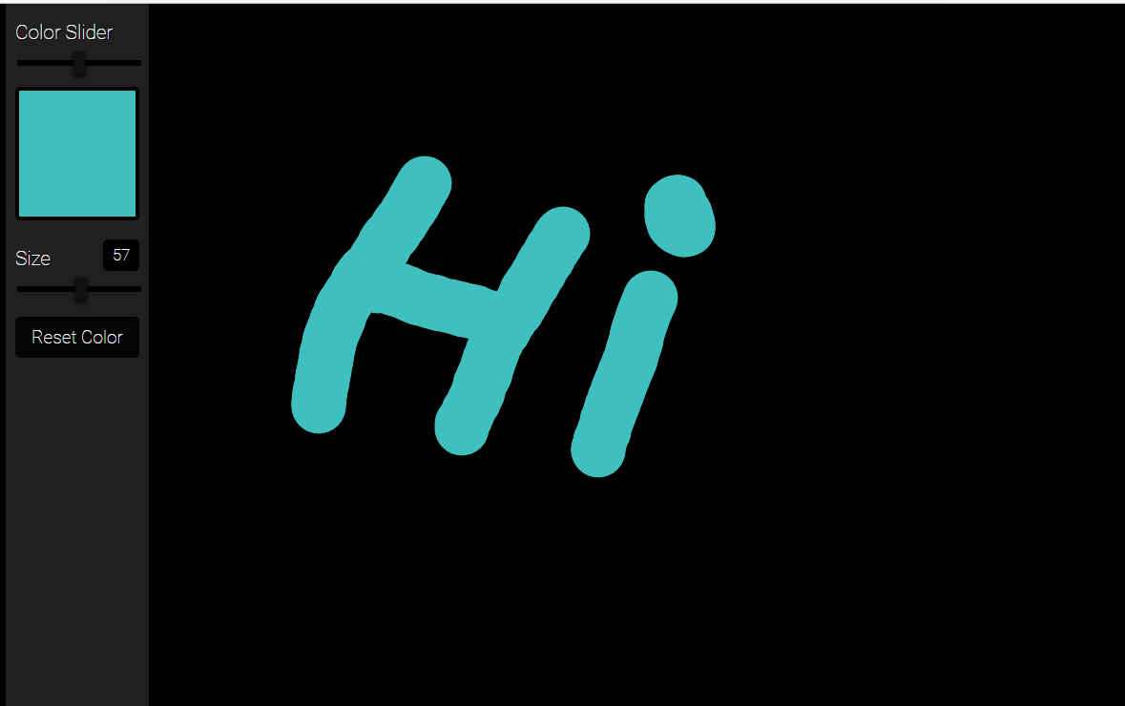
The drawing Screen

Slide 6
The drawing screen
A simple drawing screen, where you can choose a color using the color slider, alongside the dimension of the ‘brush’ using the size slider. The draw using the brush you simply have to click inside the black ‘canvas’.

Slide 7
Conclusions
In conclusion, we had managed to create a well designed screen and interface for logging in, alongside creating a drawing app with basic functionalities.

